Slide 1
Constrained Optimization Preliminaries
Ján Drgoňa
Associate Professor Civil and Systems Engineering Department The Ralph O'Connor Sustainable Energy Institute (ROSEI)
Data Science and AI Institute (DSAI)

Slide 2
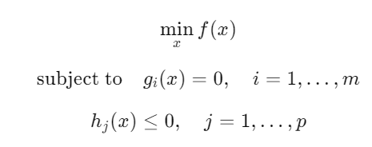
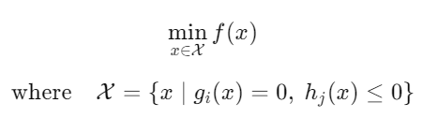
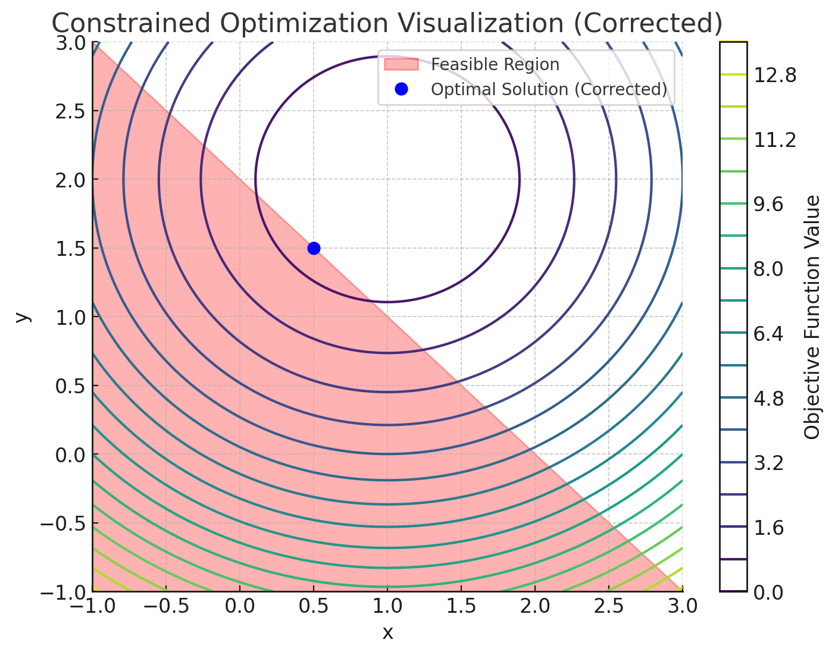
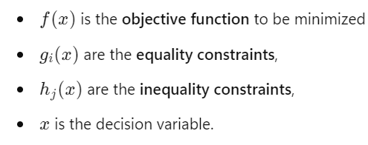
Constrained Optimization Problem
The goal is to find the best solution (optimal) to an objective function subject to constraints.
Standard optimization problem formulation:
Set notation formulation:
https://en.wikipedia.org/wiki/Constrained_optimization
https://schrimpf.github.io/AnimatedOptimization.jl/

Slide 3
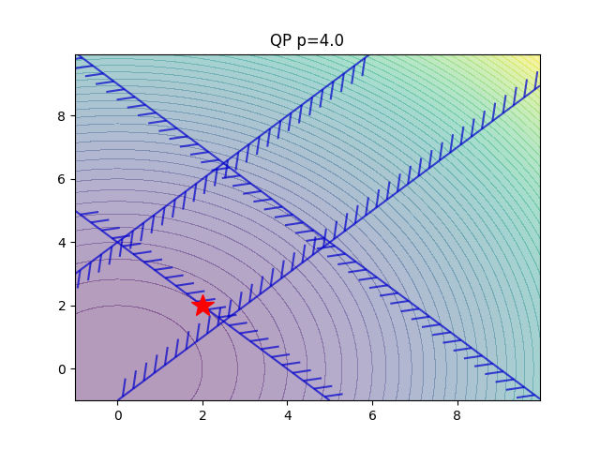
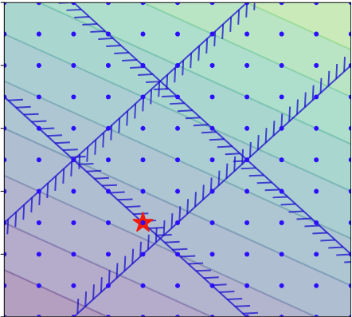
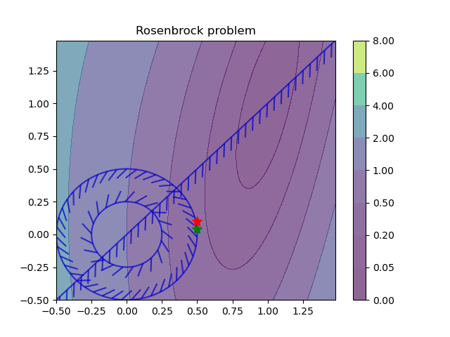
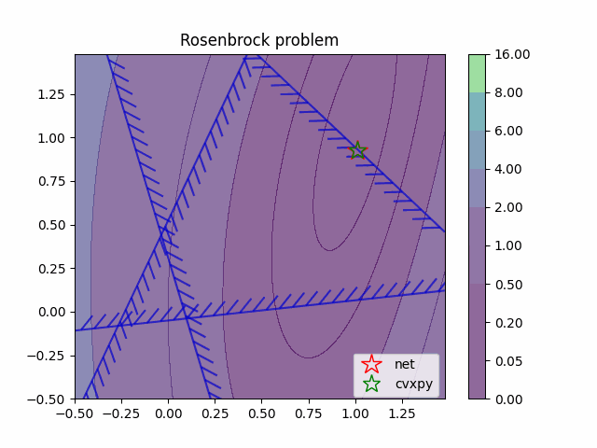
Types of Optimization Problems
Based on Constraints:
Unconstrained
Constrained
Based on Linearity:
Linear
Quadratic
Non-linear
Based on Convexity:
Convex
Non-convex
Based on Variable type:
Continuous
Integer
Mixed-integer
Based on Dynamics:
Static (decisions do not change in time)
Dynamic (e.g., optimal control)
https://en.wikipedia.org/wiki/Mathematical_optimization
https://en.wikipedia.org/wiki/Test_functions_for_optimization

Slide 4
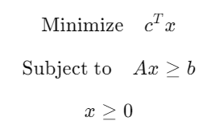
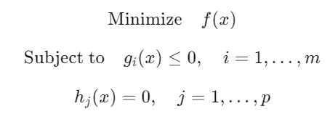
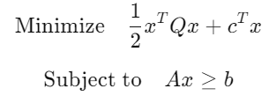
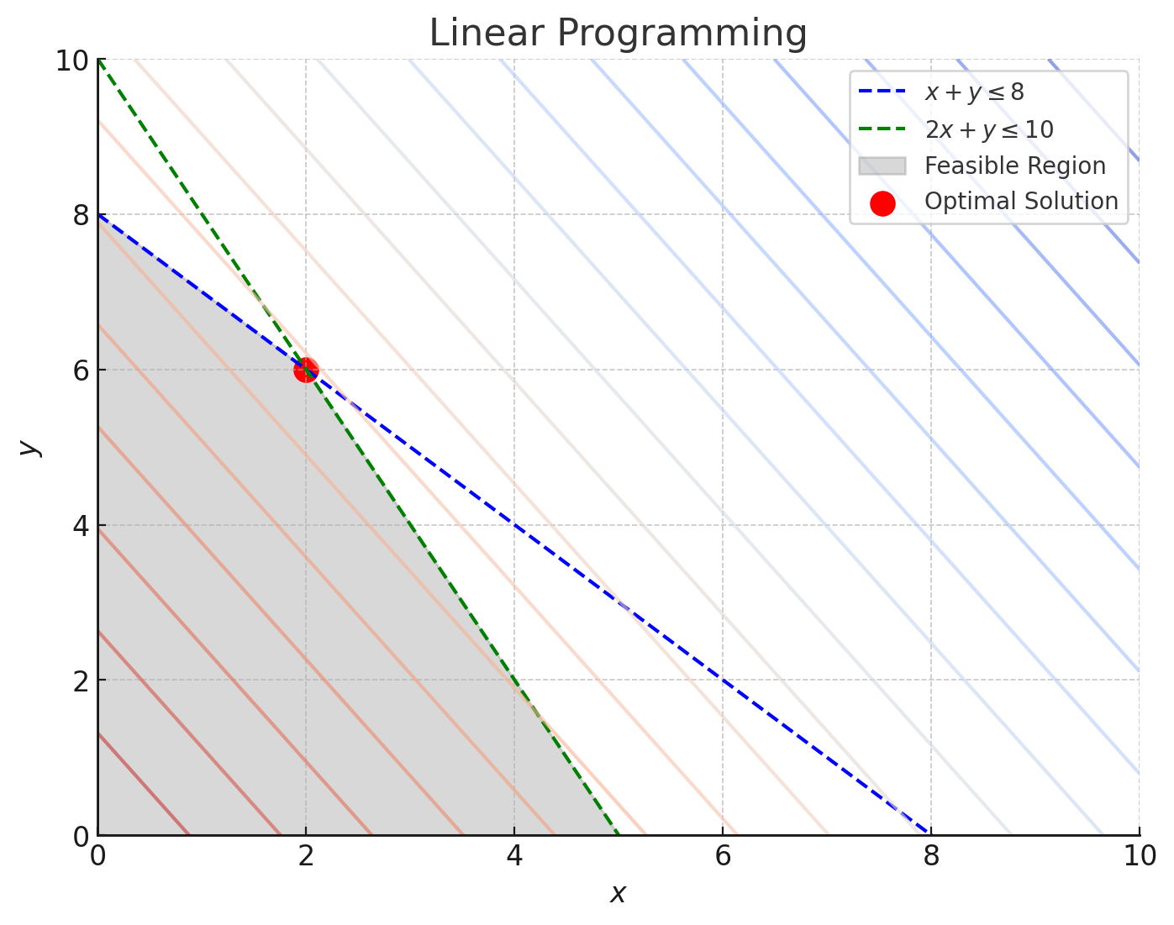
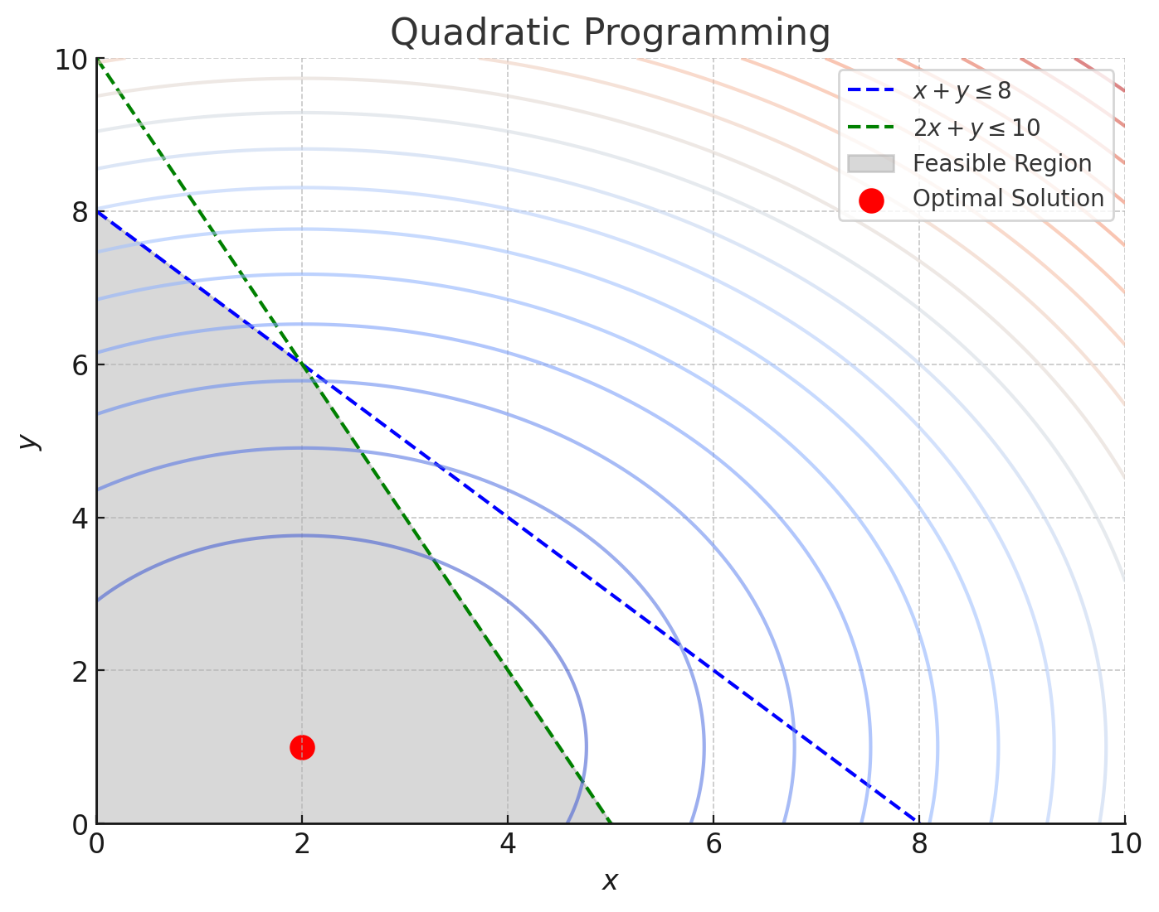
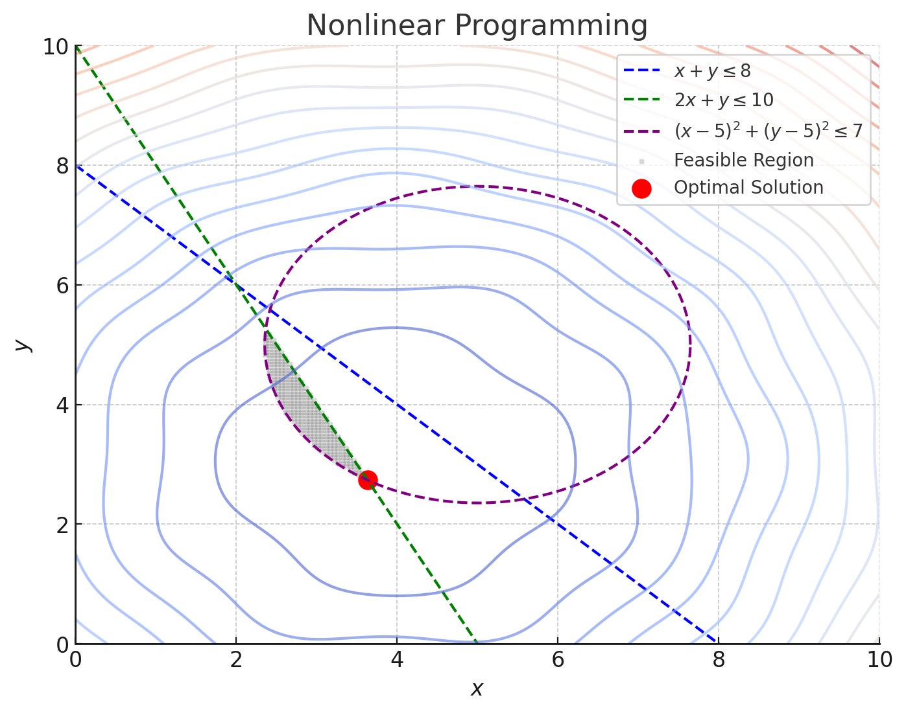
Types of Optimization Problems
Linear programming
Quadratic programming
Nonlinear programming
en.wikipedia.org/wiki/Linear_programming
en.wikipedia.org/wiki/Quadratic_programming
en.wikipedia.org/wiki/Nonlinear_programming

Slide 5
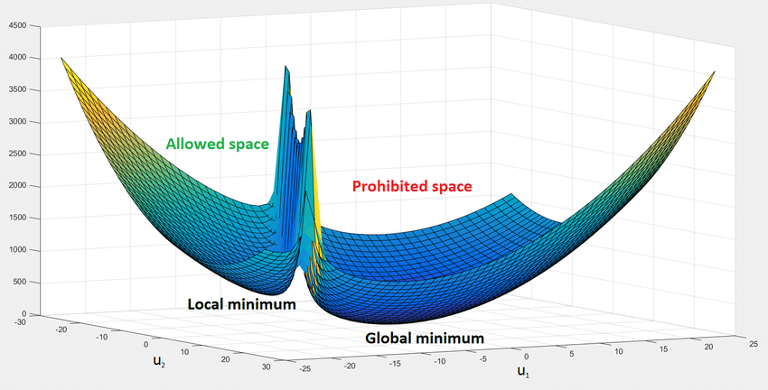
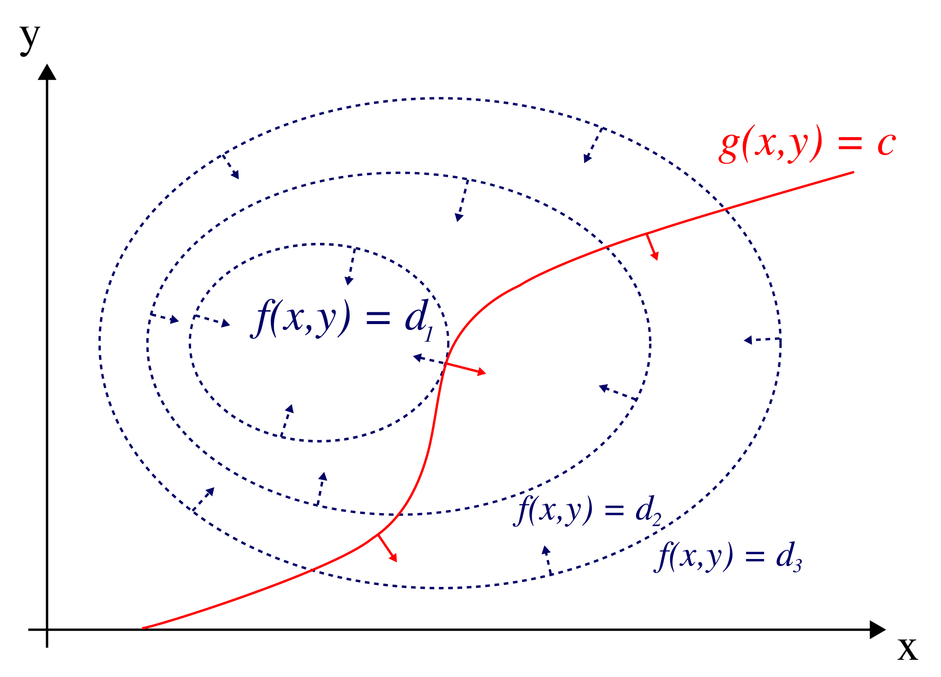
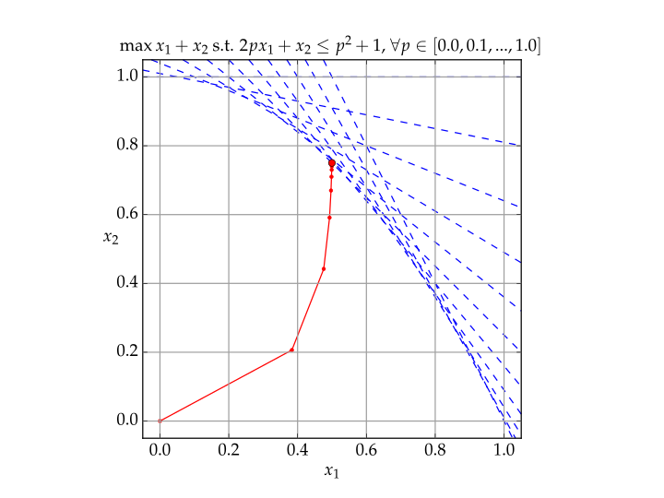
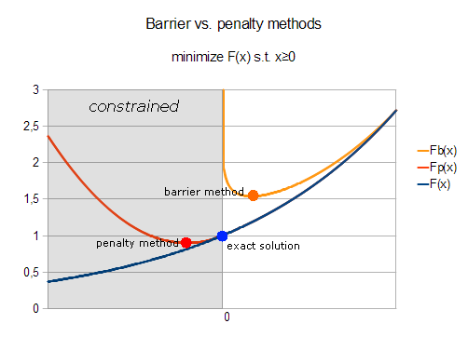
Solution Methods for Constrained Optimization
Direct methods
Indirect (Lagrange) methods
Iterative numerical methods
transform constrained problems into unconstrained
explicitly incorporate constraints using Lagrange multipliers
iteratively refine the solution, suitable for large-scale problems
https://en.wikipedia.org/wiki/Constrained_optimization#Solution_methods
https://en.wikipedia.org/wiki/Mathematical_optimization#Computational_optimization_techniques

Slide 6
Solution Methods for Constrained Optimization
Direct methods
Indirect (Lagrange) methods
Iterative numerical methods
transform constrained problems into unconstrained
explicitly incorporate constraints using Lagrange multipliers
iteratively refine the solution, suitable for large-scale problems
https://en.wikipedia.org/wiki/Constrained_optimization#Solution_methods
https://en.wikipedia.org/wiki/Mathematical_optimization#Computational_optimization_techniques

Slide 7
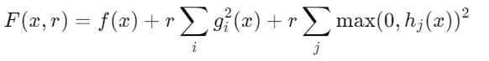
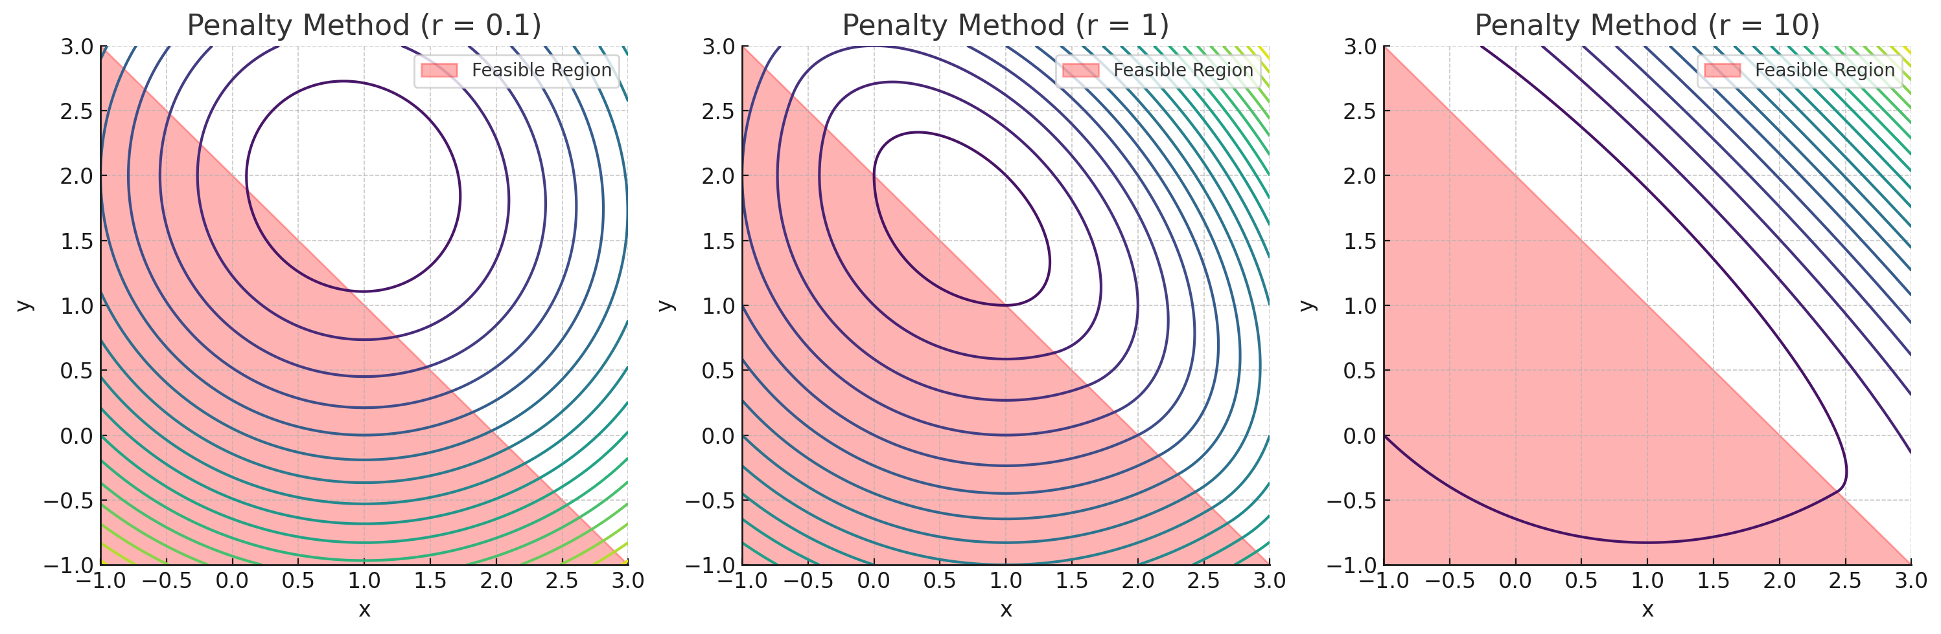
Penalty Methods
Convert a constrained problem into an unconstrained by adding a penalty for constraint violations.
The penalty function grows large when constraints are violated, r is a penalty parameter.
https://en.wikipedia.org/wiki/Penalty_method

Slide 8
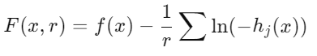
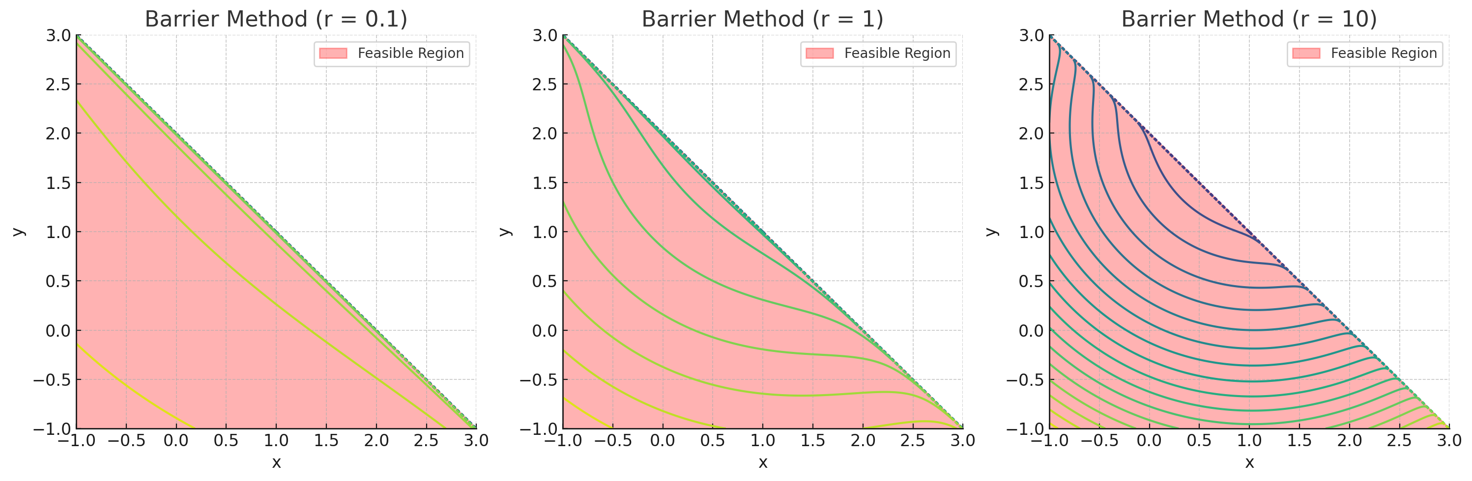
Barrier (Interior Penalty) Method
Uses a barrier function that prevents solutions from approaching constraint boundaries.
Barrier functions grows infinitely large near the constraint boundaries.
https://en.wikipedia.org/wiki/Barrier_function

Slide 9
Solution Methods for Constrained Optimization
Direct methods
Indirect (Lagrange) methods
Iterative numerical methods
transform constrained problems into unconstrained
explicitly incorporate constraints using Lagrange multipliers
iteratively refine the solution, suitable for large-scale problems
https://en.wikipedia.org/wiki/Constrained_optimization#Solution_methods
https://en.wikipedia.org/wiki/Mathematical_optimization#Computational_optimization_techniques

Slide 10
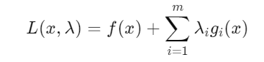
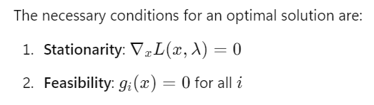
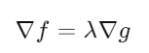
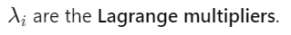
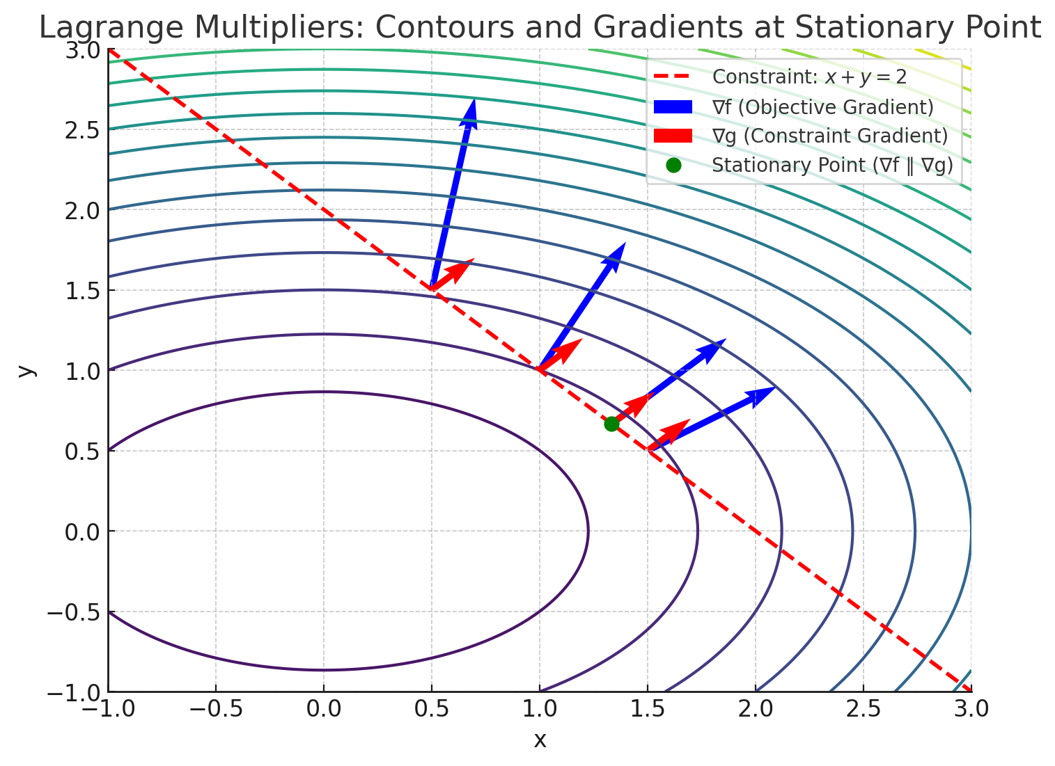
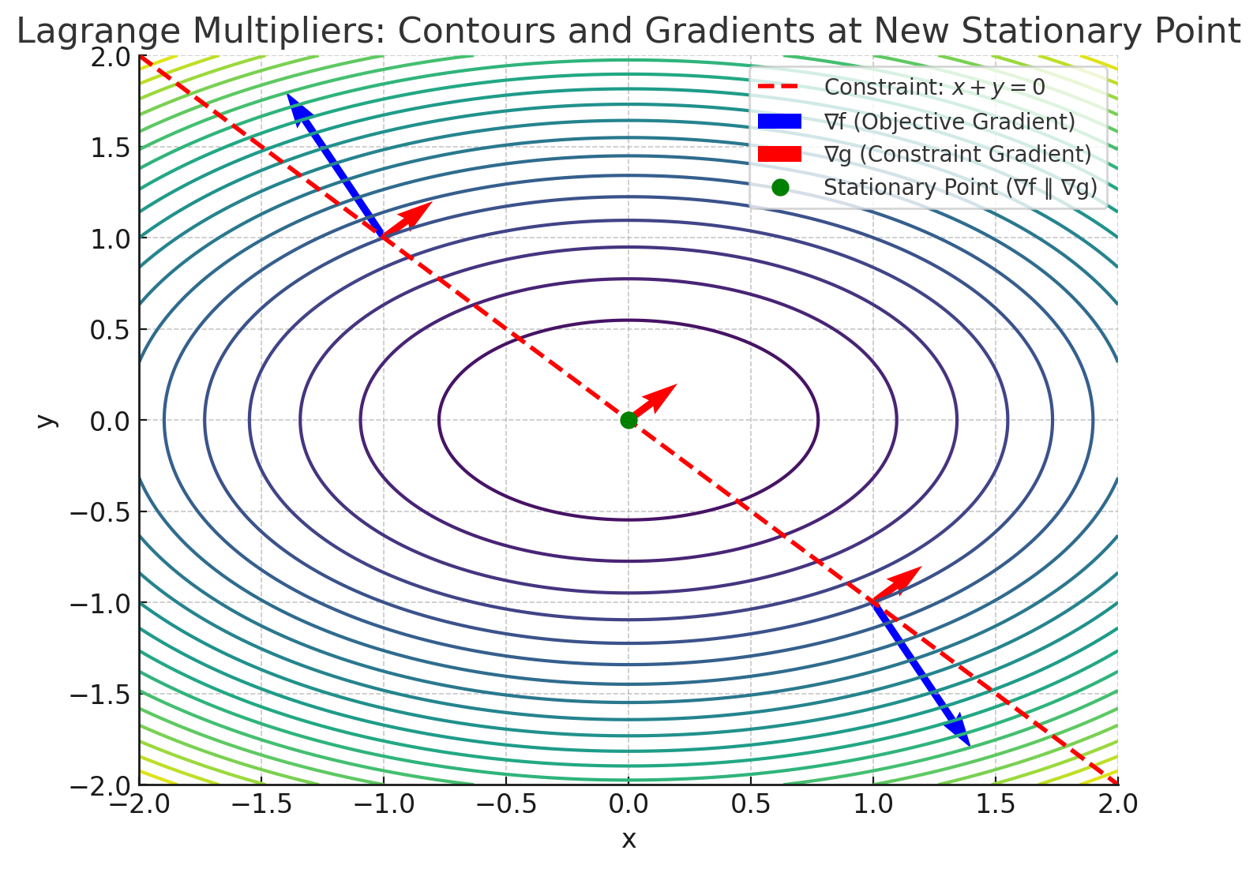
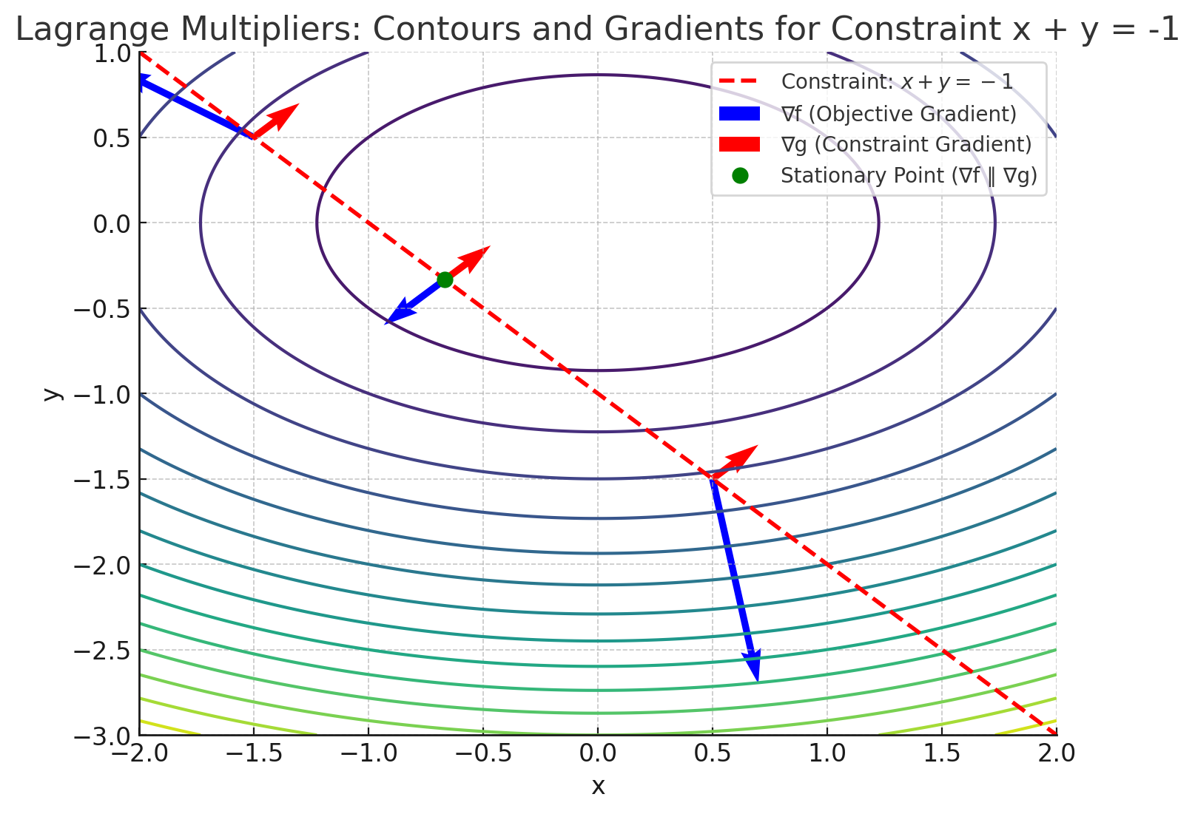
Lagrange Multiplier Method
Technique for solving equality-constrained optimization problems. It transforms a constrained problem into an unconstrained one by introducing Lagrange multipliers λ, which represent how much the optimal value of the objective function would change if the constraint were relaxed.
https://en.wikipedia.org/wiki/Lagrange_multiplier

Slide 11
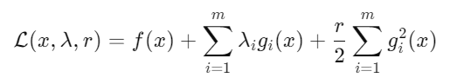
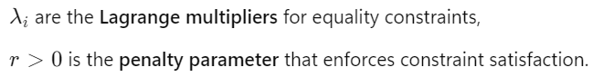
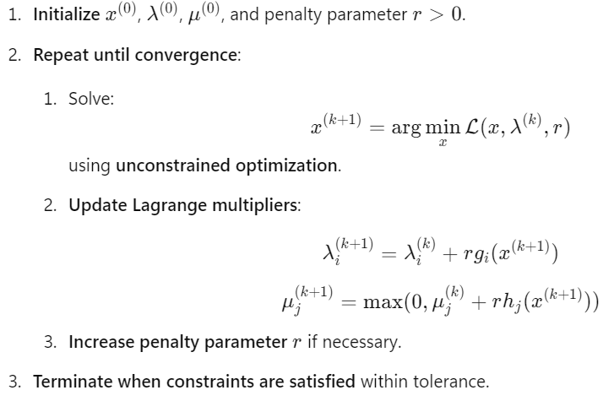
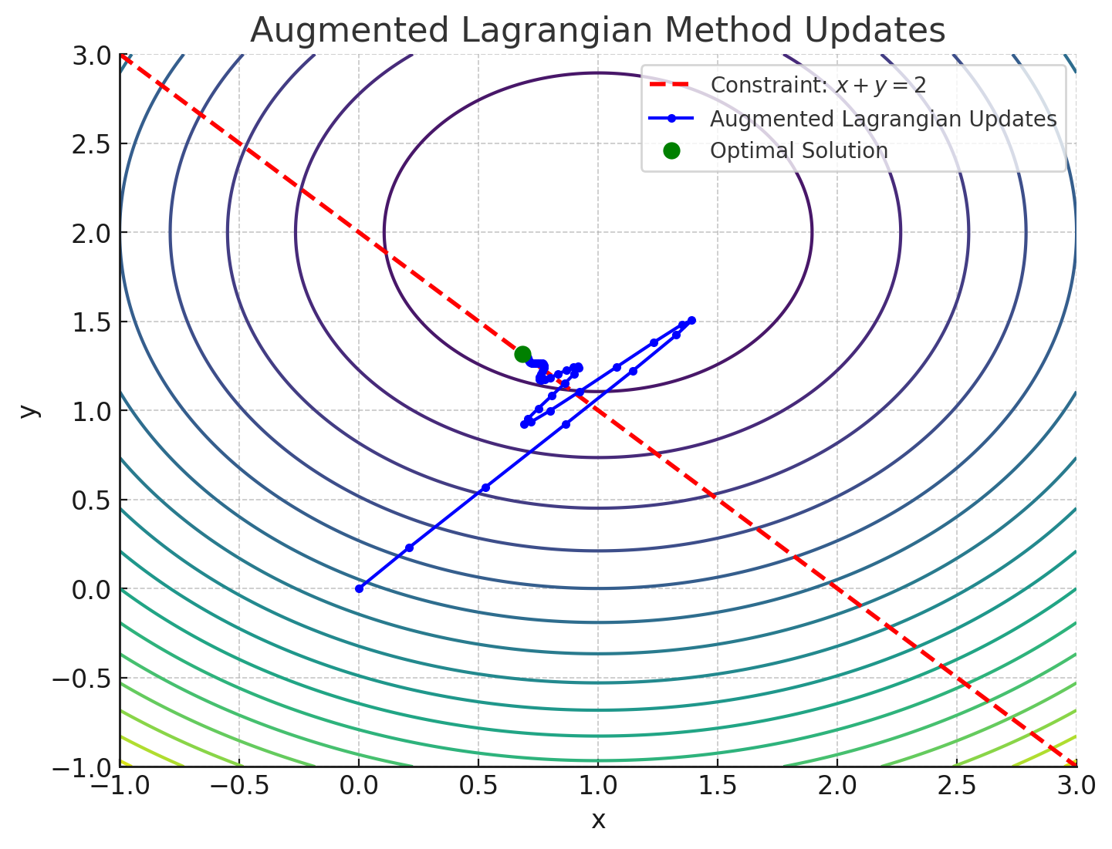
Augmented Lagrangian Method
The Augmented Lagrangian Method (ALM) is a hybrid approach that combines the Lagrange multiplier method with penalty methods to solve constrained optimization problems. It does do by augmenting the Lagrangian function F(x, λ) with quadratic penalty of the constraints.
https://en.wikipedia.org/wiki/Augmented_Lagrangian_method

Slide 12
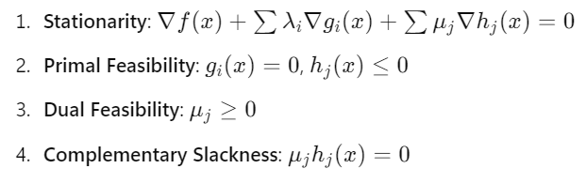
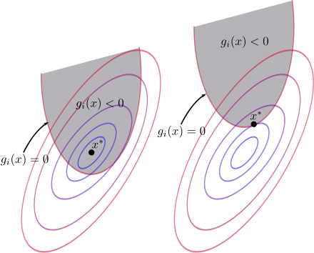
Karush-Kuhn-Tucker (KKT) Conditions
KKT conditions generalize the Lagrange multiplier method to handle inequality constraints. They are Necessary conditions for a constrained optimization problem solution to be optimal.
Stationarity: the gradients of the objective and the constraints must balance out at the optimal point.
Primal feasibility: the solution must satisfy all constraints.
Dual feasibility: the Lagrange multipliers for inequality constraints must be non-negative:
Complementary slackness condition ensures that only active constraints contribute to the optimization.
https://en.wikipedia.org/wiki/Karush%E2%80%93Kuhn%E2%80%93Tucker_conditions

Slide 13
Solution Methods for Constrained Optimization
Direct methods
Indirect (Lagrange) methods
Iterative numerical methods
transform constrained problems into unconstrained
explicitly incorporate constraints using Lagrange multipliers
iteratively refine the solution, suitable for large-scale problems
https://en.wikipedia.org/wiki/Constrained_optimization#Solution_methods
https://en.wikipedia.org/wiki/Mathematical_optimization#Computational_optimization_techniques

Slide 14
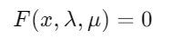
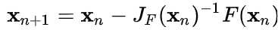
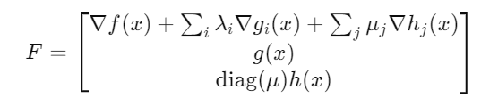
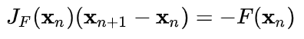
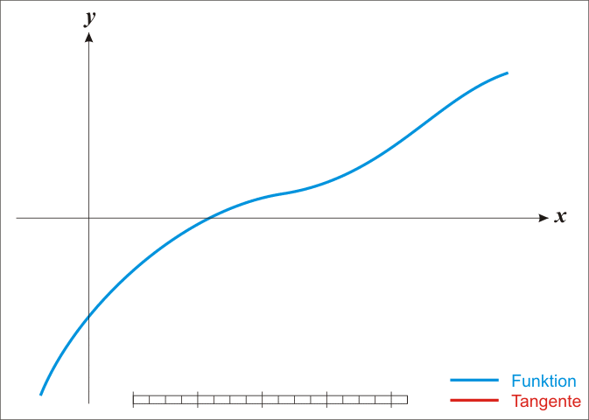
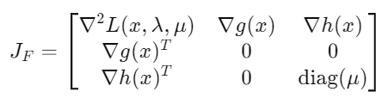
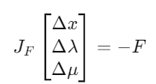
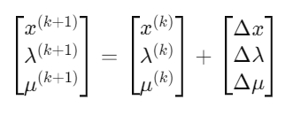
Interior Point Method
The Interior-Point Method is an optimization technique used to solve inequality constrained problems by iterating within the feasible region. It introduces a barrier function that prevents the solution from violating constraints. It solves both primal (original) and dual (Lagrange multiplier) problems simultaneously by solving the KKT conditions via Newton's method.
KKT system of equations
Newton method step:
System of linear equations:
KKT Jacobian
Solve Newton’s step
(root finding)
Update primal and dual variables
https://en.wikipedia.org/wiki/Interior-point_method
https://en.wikipedia.org/wiki/IPOPT
https://en.wikipedia.org/wiki/Newton%27s_method

Slide 15
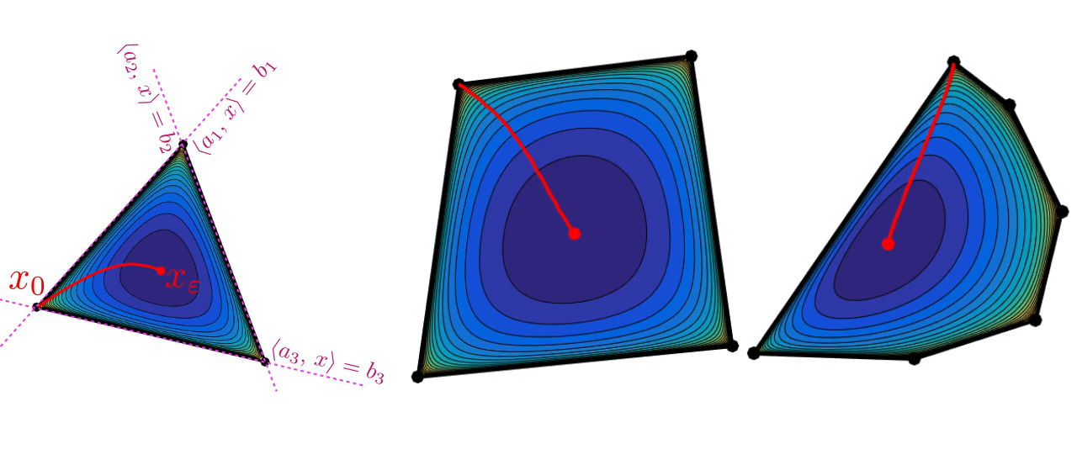
Interior Point Method
The Interior-Point Method is an optimization technique used to solve inequality constrained problems by iterating within the feasible region rather than on its boundary. It introduces a barrier function that prevents the solution from violating constraints. It solves both primal (original) and dual (Lagrange multiplier) problems simultaneously by solving the KKT conditions via Newton's method.
https://en.wikipedia.org/wiki/Interior-point_method
https://en.wikipedia.org/wiki/IPOPT
https://en.wikipedia.org/wiki/Newton%27s_method

Slide 16
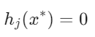
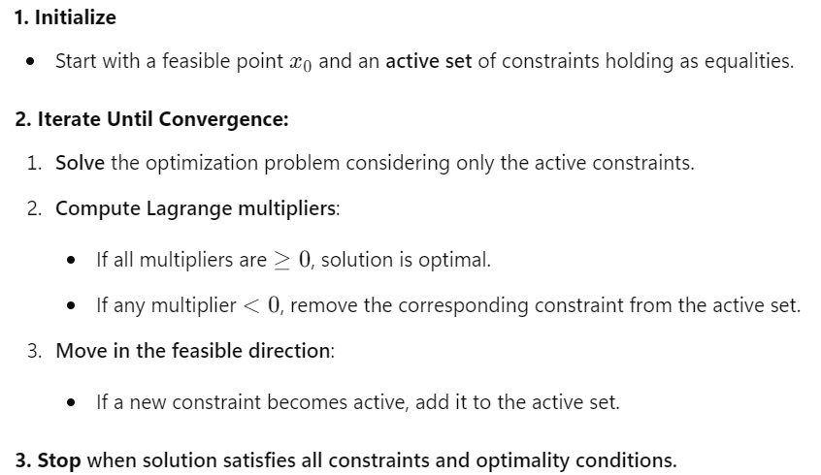
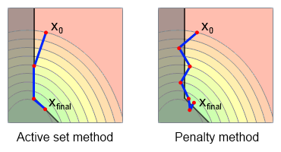
Active-Set Method
The Active-Set Method solves the constrained optimization problems by identifying a set of constraints that are active at the optimal solution and solve the reduced problem using equality constraints.
It gradually improves the solution by iterating at the boundary of the feasible region.
https://en.wikipedia.org/wiki/Active-set_method
https://www.alglib.net/optimization/quadraticprogramming.php

